Slide 1

Artificial Intelligence in Finance at Hong Kong University of Science and Technology
Notes:
What does “greedy” refer to for “greedy algorithm”?
Optimal at the current step
Monetary reward gained in the training process
Binary splitting using neural networks
None of the above
What happens when there are too few steps of splitting in a tree?
Large bias, large variance
Large bias, small variance
Small bias, large variance
Small bias, small variance
In a decision tree, if the current split is ineffective, future splits can still be effective (even very effective).
True
False
Which of the following are usually used to evaluate the quality of a split in a classification tree?
Gini-index and splitting bias
Cross-entropy and splitting bias
Gini-index and cross-entropy
All of the above
Which of the following is true about bagging?
Works best for high variance and high bias learning methods
Works best for high variance and low bias learning methods
Works best for low variance and high bias learning methods
Works best for low variance and low bias learning methods
Which of the following is true about boosting?
A combination of many weaker learners to produce a strong learner.
Weaker learners are usually created in parallel.
Boosting is only applicable for classification problems.
None of the above

Slide 2
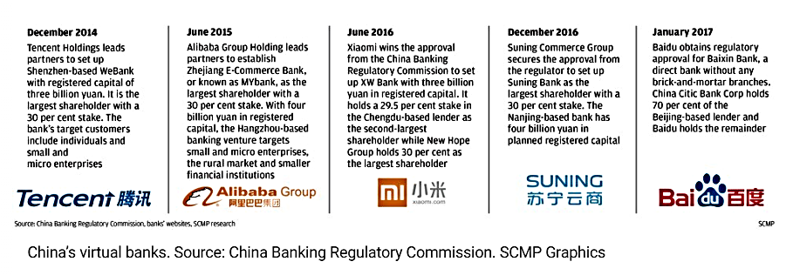
Virtual Banks in Hong Kong
A “virtual bank” refers to a bank which delivers retail banking services primarily, if not entirely, through the internet or other forms of electronic channels instead of physical branches.

Slide 3
Virtual Banks in Hong Kong: Announcement
The HKMA has announced that as part of the package of initiatives it introduced in September 2017 to bring Hong Kong into a new era of smart banking, it will facilitate the establishment of virtual banks in Hong Kong
On March 27, 2019, HKMA released the first three licenses to:
Livi VB, co-owned by Bank of China (Hong Kong), JD Digits and Jardines
SC Digital Solutions, a joint venture between Standard Chartered, HKT, PCCW and Ctrip
Zhong An Virtual Finance, a joint venture between ZhongAn Online and Sinolink

Slide 4
Virtual Banks in Hong Kong: Impact
Increasing competition (virtual vs. traditional) - HK becomes one of the most heavily saturated for banking services globally
SCB, HSBC, BOC(HK): 66% of lending market, 77% of mortgage market, 76% credit card market, 50% of deposit market → decrease
But traditional banks already have online banking services which have similar functions to virtual banks
Bringing new models and experience to the banking sector - Many non-banking companies will join the sector, e.g. WeLab
Cross-border (regionally and internationally)
Transparency
Jobs market will be different (traditional VS new)

Slide 5
Virtual Banks in Hong Kong: Challenges
Hard to gain trust from customers for new entrants (young vs. elderly)
Competition with traditional bank’s digital services
Regulation - probably even tougher (especially Cyber Crimes)
Technology development and risk management
Enormous demand from non-bank financial actors from Mainland China, but requirement of HK$ 300m is still very high, i.e. Big Boys’ Game

Slide 6
Course Schedule
Session | Date | Topic | Application & Case Study | In-Class Activity
1 | Feb 1 | History and Overview of Artificial Intelligence | Google Experiments: Draw! | Kahoot
2 | Feb 15 | Supervised & Unsupervised Learning Classification vs. Regression | Google Experiments: Vision Sensing Case study: HireVue (Video Analytics for Recruitment) | Class survey and group formation Kahoot
3 | Feb 22 | Regression & Classification Model Assessment and Selection | Speaker: Katrina Fong | Kahoot
4 | Mar 1 | Decision Tree & Random Forests Boosting | Credit analysis Mock interview by Katrina | Kahoot
5 | Mar 8 | GPU Tutorial |  | Kahoot
6 | Mar 15 | Blockchain | Speaker from VEE Technology LLC | Sharing from researchers and industry professionals
7 | Mar 22 | Neural Network Basics Perceptrons | Speaker: Mr. Jeffrey Hui | Word2Vec Kahoot
8 | Mar 29 | Recurrent Neural Network (RNN) LSTM | Google Image Recognition Case study: SenseTime (Computer Vision) | 3D Visualization of CNN Kahoot
9 | Apr 12 | Reinforcement Learning | Case study: Osaro (Robotics), Ascent (Autonomous Driving) | Kahoot
10 | Apr 26 | GAN |  | TBA
11 | May 3 | TensorFlow Implementation | Recap of concepts Case studies: Airobotics (Drones), Cornami (AI Chip) | Kahoot
12 | May 10 | Frontiers of AI Challenges in AI Commercialization | Recap of concepts Case studies: Prophesee (Computer Vision), Prowler (AGI) Speaker: Mr. Christopher Lee | Review of Neural Ordinary Differential Equations (NIPS 2018)
13 | May 17 | Synthesis & Outlook |  | Final presentations (details TBD)
Note: Details may change depending on class progress, development of relevant technologies, as well as information and feedback from students’ surveys.

Slide 7

The Honor Roll: Analytics
Di! Student Card
For a detailed proposal with techniques such as Laplace smoothing, PCA
Orange
For devising 19 solutions to track and monitor private companies
HappyAImen
For finding 14 ways with solid rationale underlying each approach

Slide 8
The Honor Roll: Correspondence
Di! Student Card
For being inclusive with proper language
Gesha
For being inclusive with proper language
HAWK
For being inclusive
Orange
For being inclusive with proper language
Pharaoh
For being inclusive
Skyfall
For being inclusive with proper language
Sweetie
For being inclusive with proper language

Slide 9
From: Team Leader E-mail
Subject: Option B - Assignment I - Project X
To: Instructor E-mail
Cc: Team Member 1, Team Member 2, Team Member 3…
Dear Anthony,
Attached please find our assignment I.
Let us know if you have any questions. Thank you.
Best,
Team Leader Name

Slide 10
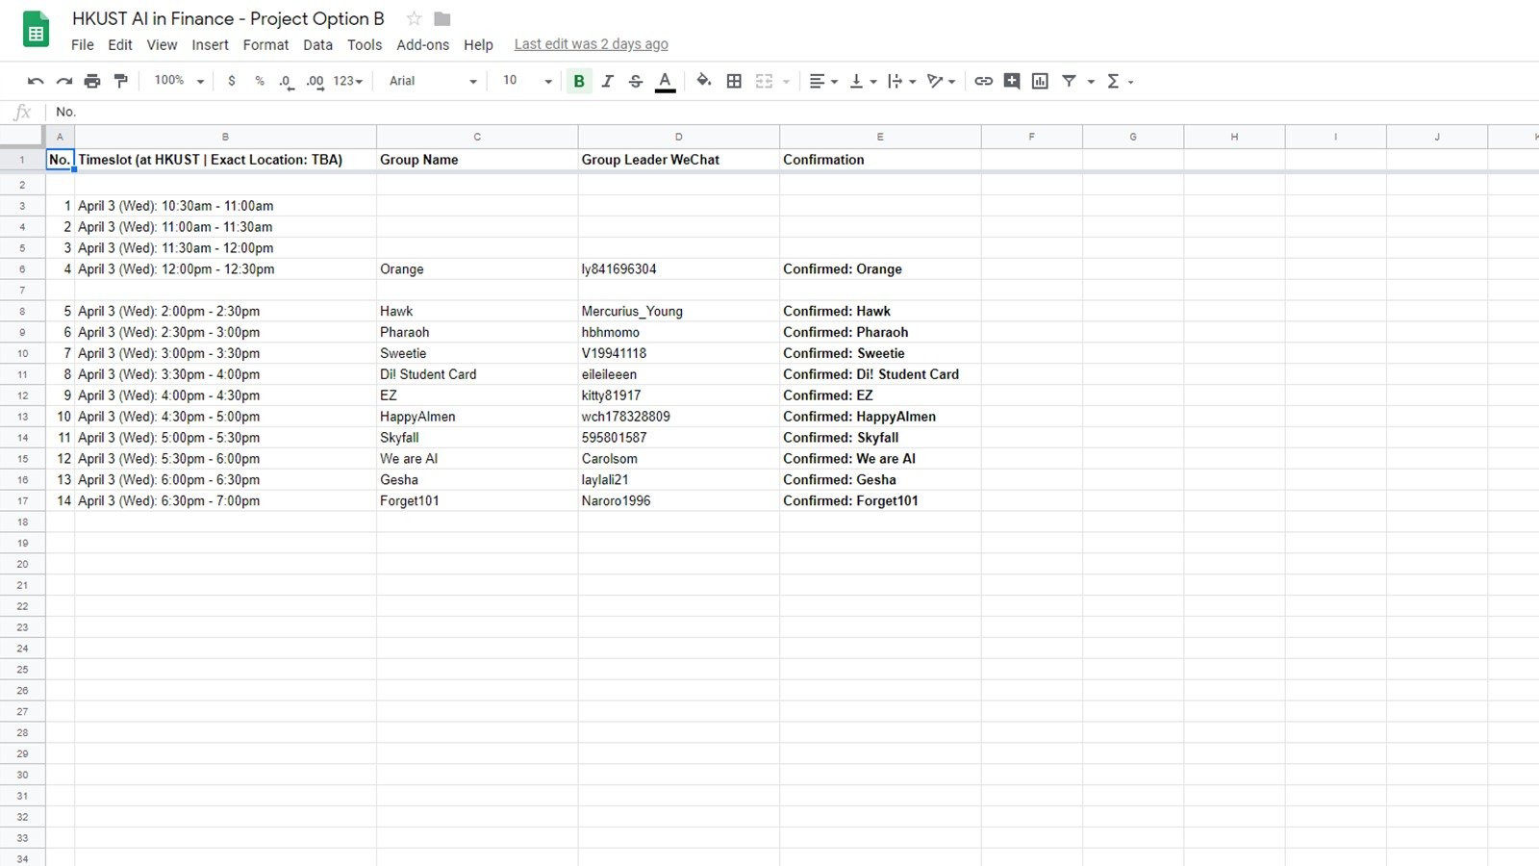
https://goo.gl/iUZ8gP

Slide 11
Consultative Session Protocol
Leader report on current status
Key questions and issues
Brief report from each team member
Direct Q&A with each team member
Next steps and future direction

Slide 12
Consultative Session: Tips & Best Practices
Because it is a company internship, you are held accountable to corporate standards (US standards, to be specific)
Not mandatory, but “highly recommended”
Same for company meetings, which range from “DS Co. Daily Update” to “Alibaba Annual Meeting”
If you cannot attend, ask your teammates to talk on your behalf
Be concise, clear, and straight-forward. Talking more does not mean a better result
There may be team members who are not very eloquent or articulative, you get points for helping each other. In fact, you both get points, so it is a “win-win”
It is a dialogue and a discussion. No one knows what the “true” answer is, so having some sense of the right direction matters more than what is right vs. wrong
There will be more of these sessions, so stay tuned
Because it is a company internship, you are held accountable to corporate standards
Not mandatory, but “highly recommended”
Same for company meetings, which range from “DS Co. Daily Update” to “Alibaba Annual Meeting”
If you cannot attend, ask your teammates to talk on your behalf
No one knows what the “true” answer is, so having some unified direction matters more than what is right vs. wrong
Be concise, clear, and straight-forward. Talking more does not mean a higher score
There may be team members who are not very eloquent or articulative, you get points for helping him or her (in fact, you both get points, so it is a “win-win”)
There will be more sessions; some may ask whether the consultative sessions are mandatory, the real answer is yes and no… possibly “passively-mandatory”

Slide 13
Kahoot! Hiatus
Which of the following is not a building block of the perceptron?
Which of the following is true regarding ResNet (2015)?
Correct Answer
Incorrect Answer
Average Time Taken
Explain every Kahoot! Question
Show Kahoot! statistics if possible
Explain convolution, softmax
Slido on slide screens
Slides on Convolution

Slide 14
Kahoot! Hiatus (Cont’d)
Which of the following is applied when training AlexNet (2012)?
Which of the following assigns probability for image classification in a CNN?
Correct Answer
Incorrect Answer
Average Time Taken

Slide 15
Kahoot! Hiatus (Cont’d)
For a fully connected layer, what would a 16x16x1 image become?
What is the output after convolving six (6) 5x5 filters on a 32x32x3 image?
Correct Answer
Incorrect Answer
Average Time Taken

